Slide 1
CICOTI Mozambique: BAT QBR April 2018

Slide 2
Overview
Volume by Region
Top Customers
Branch Performance
Brand Performance
AC Analysis
Breakdown Report

Slide 3
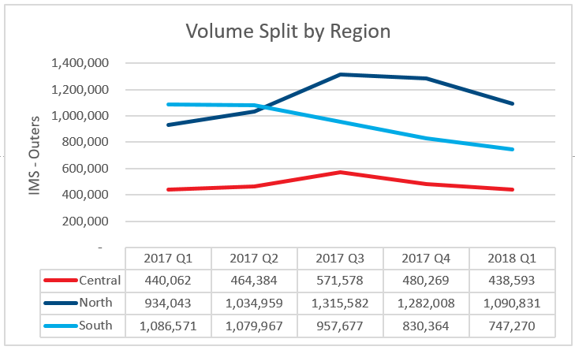
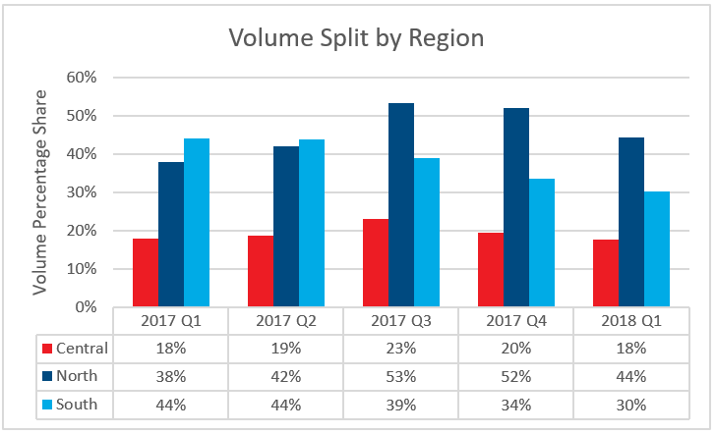
Volume Split Per Region YoY

Slide 4
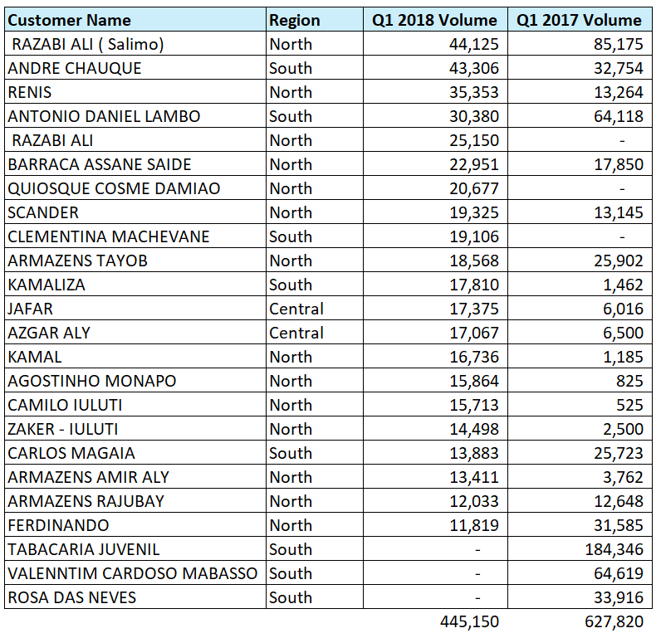
Top Customers

Slide 5
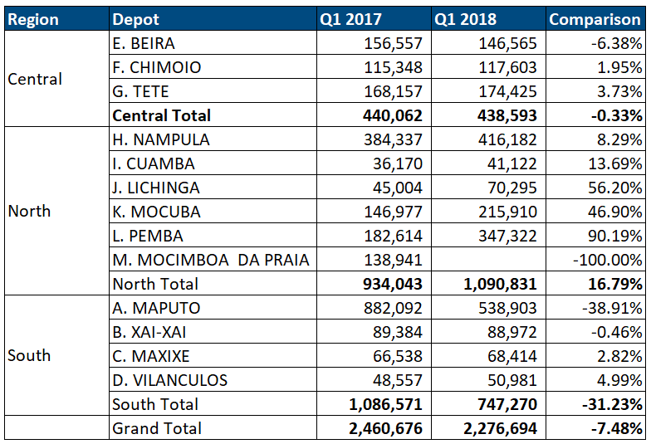
Branch performance

Slide 6
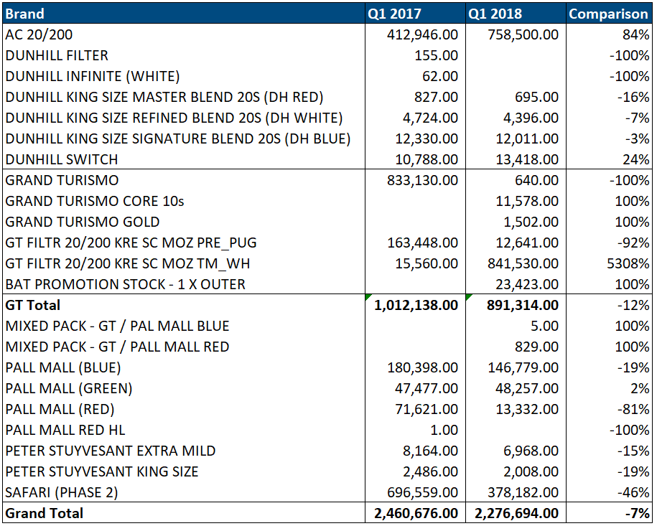
Brand performance

Slide 7
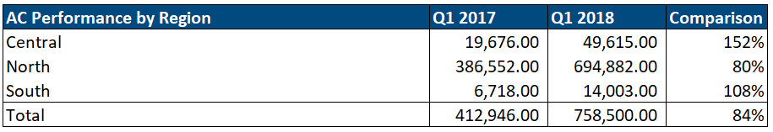
AC Analysis

Slide 8
Breakdown report
Region | Branch | Vehicle | Comment
Central | Tete | NP300 | Vehicle repair complete. Awaiting insurance payment
North | Nampula | UD80 – Truck | Quotes submitted to insurance awaiting approval. Mt. 550,000 to repair
North | Mocuba | KB250 | Waiting for Canopy from Maputo.
North | Pemba | KB250 | Busy with repair
North | Nampula | NP300 | Chassis replaced. Waiting for replacement oil pump.
North | Cuamba | KB250 | Major Breakdown. Chassis snapped. Waiting for parts from SA.

Slide 9
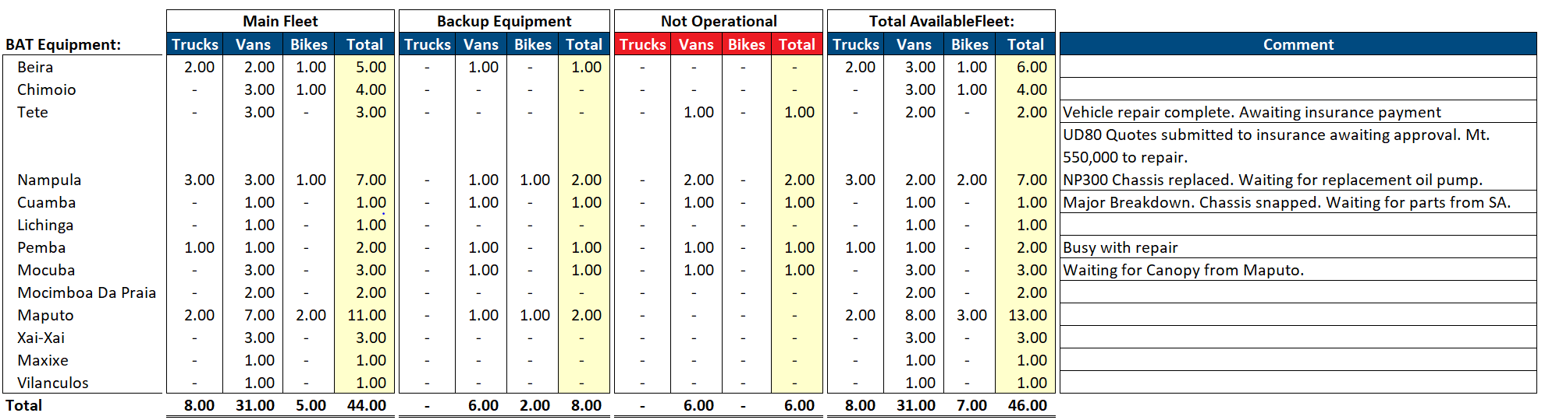
Breakdown report

Slide 10
Thank you.

